Slide 1

Recommender System & Chatbot
AI Studio Final Presentation
Social Science Research Council 1B
December 4th, 2023

Slide 2

Introductions

Slide 3


Meet Our Team!
Loyd Flores CUNY Queens College
Labiba Aziz
CUNY Queens College
Fatima Ali SUNY Farmingdale
Xinyu Huang CUNY Baruch College
Kirsty Ihenetu Barnard College

Slide 4


Our AI Studio TA and Challenge Advisors
<insert jpg>
<insert jpg>
Ryan Hardesty Lewis AI Studio TA
Rebecca Gluskin Challenge Advisor

Slide 5
Presentation Agenda
Overall Project Challenge
Pannel Challenge and Potential Impact
AI Studio Project Overview
Data Collection
Data Cleaning
Feature Engineering
Clustering
Recommender System
Chatbot
Implementation
Demo
3. Final thoughts and Closing

Slide 6
“
Pannel Challenge and Potential Impact :
A more efficient way of accessing the Census API, by making DATA2GO.NYC even easier to use. How?
1. A data recommendation system for variables, correlations, and infographics based on the key search terms they are already looking for.
2. An interactive Chatbot/Assistant where you can have deeper insights

Slide 7
Our Goal and Potential Impact
To enhance the accessibility and user experience of DATA2GO.NYC for those with limited technical proficiency, we propose a multifaceted approach. This includes:
User-Friendly Interface Redesign: Simplify the interface to make it easy for users of all technical levels to access and understand the data.
Advanced Analytical Tools: Add tools for deeper analysis, helping users easily find and understand complex data correlations.
Comprehensive Data Coverage: Ensure that all important variables are included, providing a more complete and accurate data set.
Enhanced User Engagement: Create interactive features to make the platform more engaging and easier to use, encouraging wider exploration of the data.

Slide 8
AI Studio Project Overview

Slide 9
Our Approach
Business Understanding / Website Exploration
Going through the Data2Go website and gathering insights on our future ML models. Each member also created data stories based on personal experience and highlighting variables that captures our interests.
Data Cleaning & Modeling
Removing unnecessary columns/rows and employed feature engineering to enrich the dataset. Applied clustering on the ‘Sector’ variable to understand patterns and relationships within the dataset.
September
November
August
October
Data Exploration and Sourcing
Alternating between 2 data acquisition approaches: pulling data from the Census API website using R and directly accessing the data by downloading it from the Data2Go website. Understanding the dataset and identify variables that are relevant to analysis.
Implementation of Recommender System & Chatbot
Creating a correlation matrix to understand the correlation between different variables which provided valuable insights for the recommender system and chatbot.

Slide 10









Resources We Leveraged
Google Collab
VS Code
GitHub
RStudio
Kaggle
ChatGPT

Slide 11
Data Collection

Slide 12
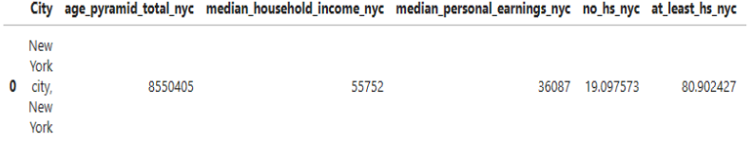
Data Collection
Data Pulled from the Census using slightly modified code provided to us
Had to pull for multiple years

Slide 13
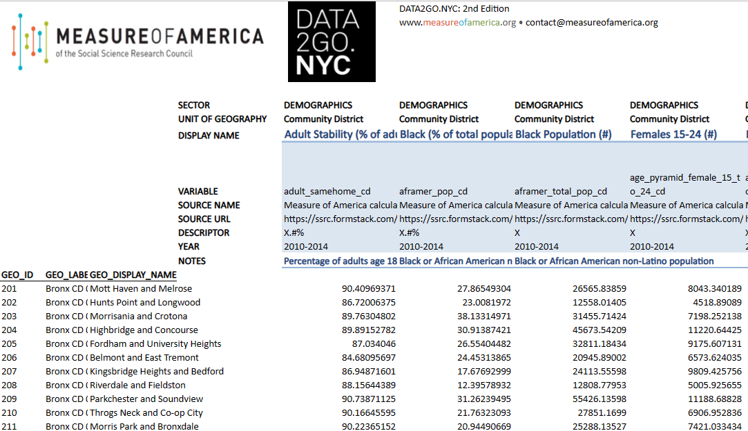
Data Collection
Dataset provided within the DATA2GO.NYC website

Slide 14
II. Data Cleaning

Slide 15
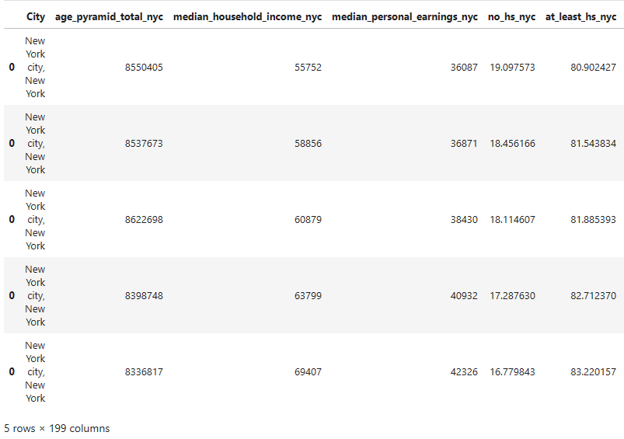
Data Cleaning - Census Data
Combining multiple years because each year was a separate dataset

Slide 16
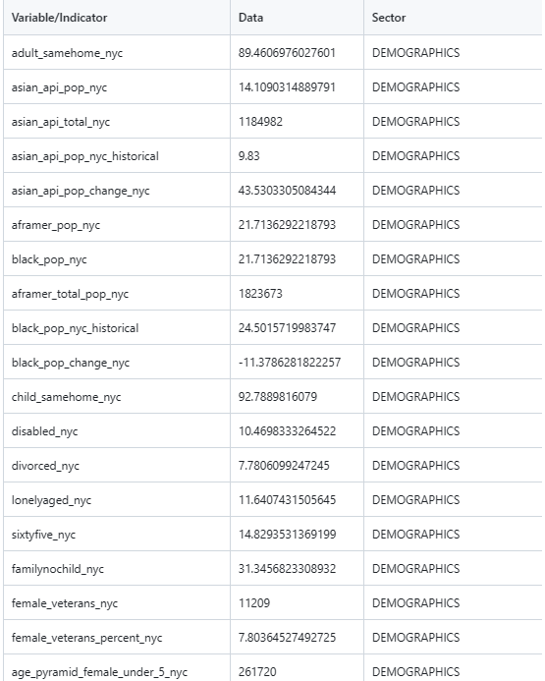
Data Cleaning - DATA2GO.NYC data
Extracting necessary rows and columns and pivoting data
Data originally came as a row, we converted each column into a row entry
Could only use 5th and 4th version because the older versions had different formatting (Variable names, # of total indicators varied)

Slide 17
III. Feature Engineering

Slide 18
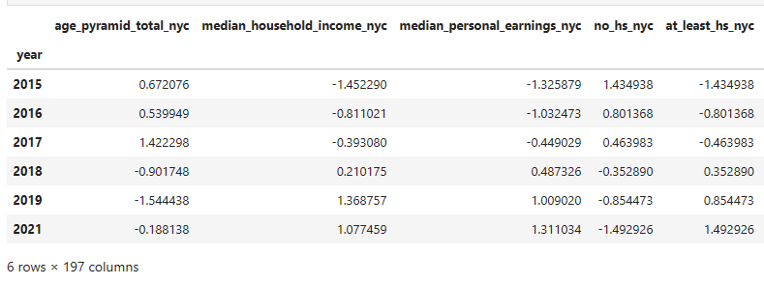
Feature Engineering - Census Data
Removing the city column and replacing the index to the year of which the data was pulled

Slide 19
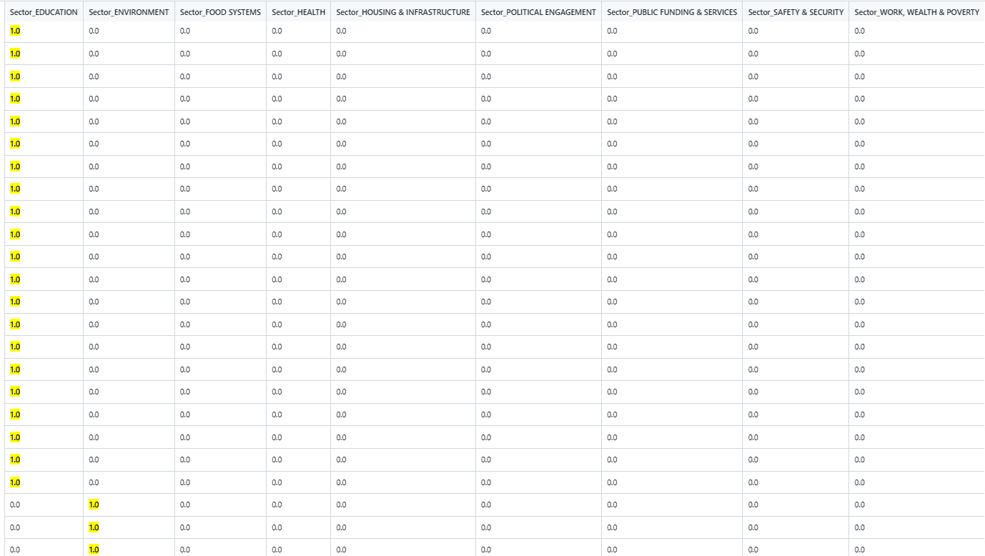
Feature Engineering - DATA2GO.NYC
With limited data, we One hot encoded the “sector” column to allow us to make correlations
- 1 : In this sector
- 0 : Not in this sector

Slide 20
IV. Clustering

Slide 21
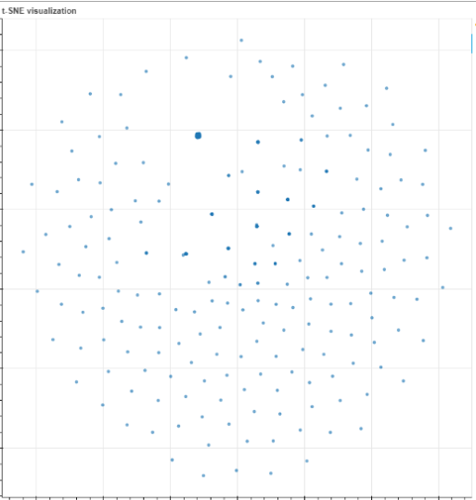
Clustering with K-means
Pre clustered data
How does our data look?
First assumptions
Pre-processing steps :
Standardization of values using, from sklearn.preprocessing import StandardScaler because some values were percentages (%), and others were solid or total count values.
Optimal Hyperparameter : # of clusters

Slide 22
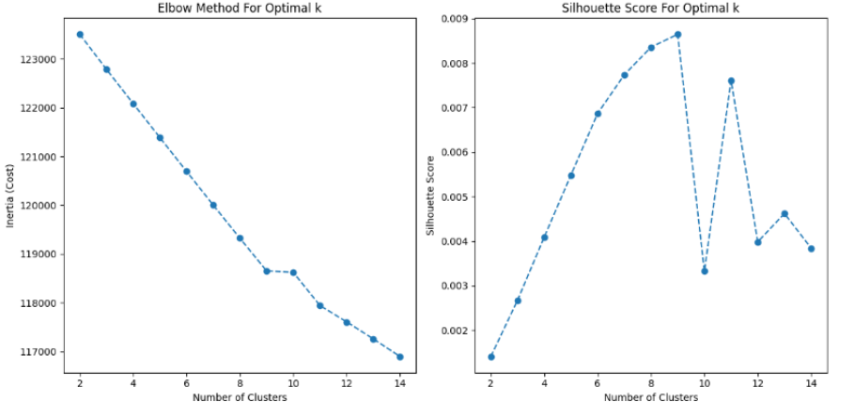
Clustering with K-means
K-means requires a hyperparameter : # of clusters
We used 2 methods to verify the best number of clusters
How Best Hyperparameter is determined: 1. Elbow method - Value before plateau
2. Silhouette Score - Value before the steepest drop

Slide 23
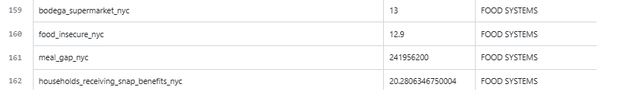
Optimal number of hyperparameters : 6
We started out with 10 sectors (Education, Health, Environment,...), and ended up with 6? Why?
If we use too few clusters it may oversimplify the data, if we use too much it may overfit and not accurately cluster. In summary they might not be accurate.
Clustering removes 1 sector, and implicitly if you a data point isn’t clustered to any explicit cluster implicitly it is part of the unstated or removed cluster.
Some sectors had limited entries, making that sector not as impactful as others,
Ex : Food Systems only had 4 entries. This sector could be merged.

Slide 24
V. Correlation Analysis & Recommender System

Slide 25

Correlation Analysis using Correlation Matrix correlation_matrix = df.corr()
Problems Faced as we attempted to correlate:
There were clusters being formed in the previous step, but no correlation could be extracted out of the DATA2GO.NYC data since it was only 2 years.
Solution :
We were stuck and opted to attempt to cluster using the cleaned data from the census, despite losing some variables it was a tradeoff for a more accurate model that could correlate our data

Slide 26
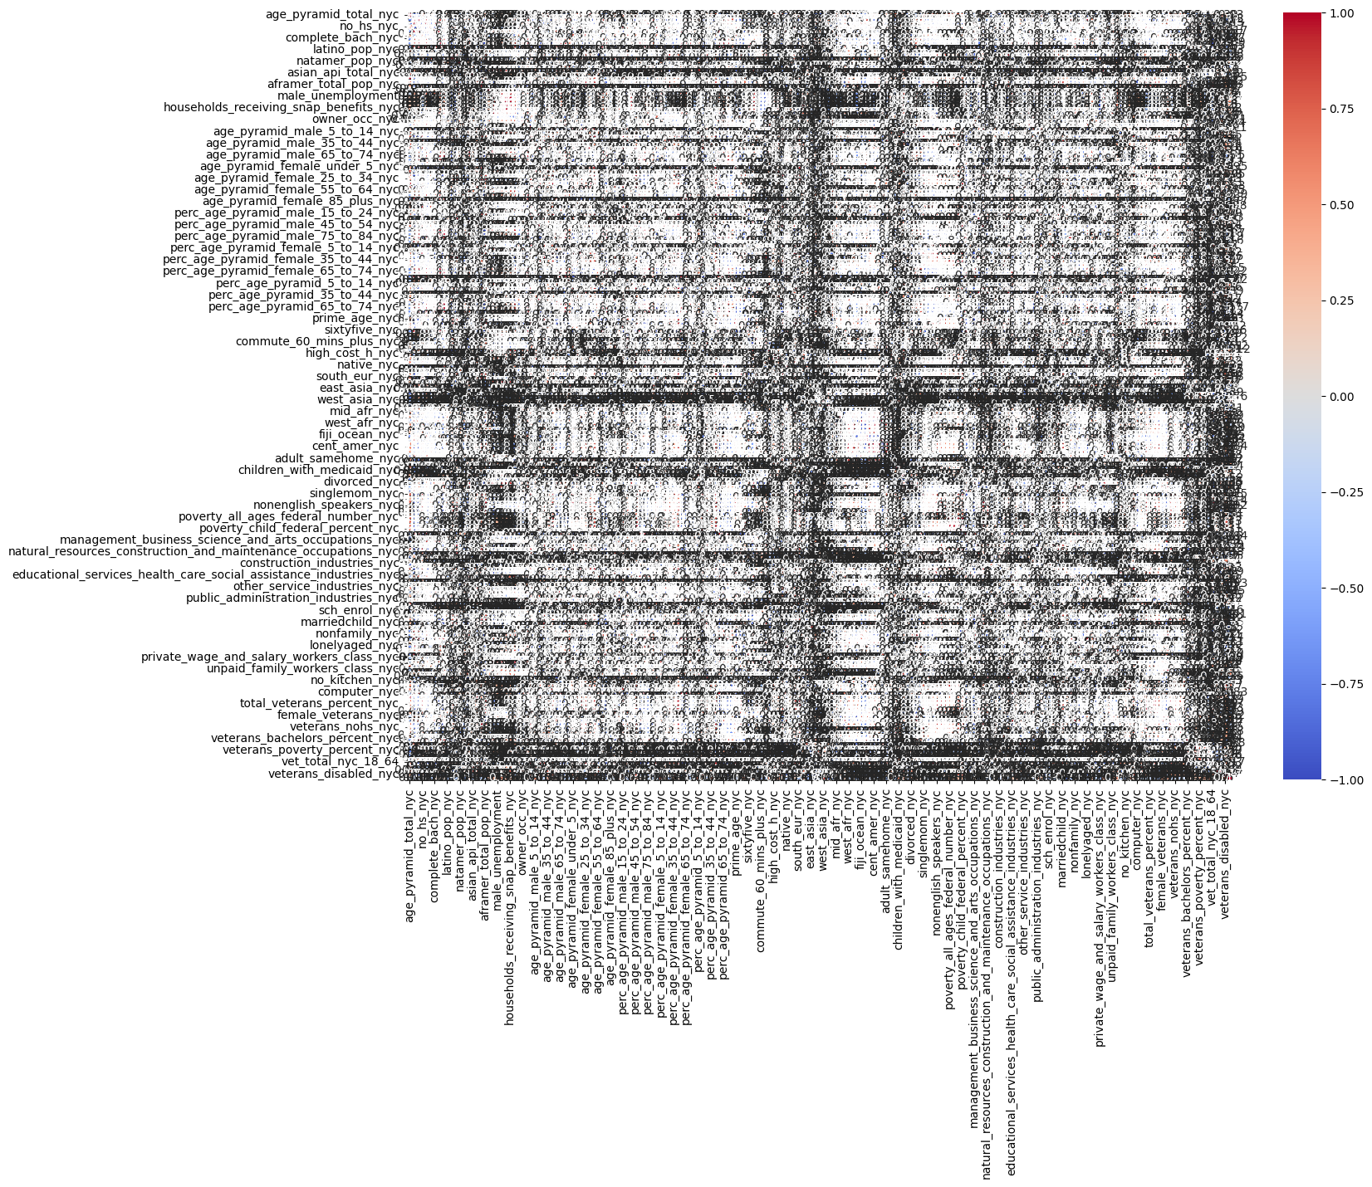

Correlation Matrix (All variables)
It worked! Correlations were formed with the Census Data!
This graph is unreadable due to the 197 variables compared to each other.

Slide 27
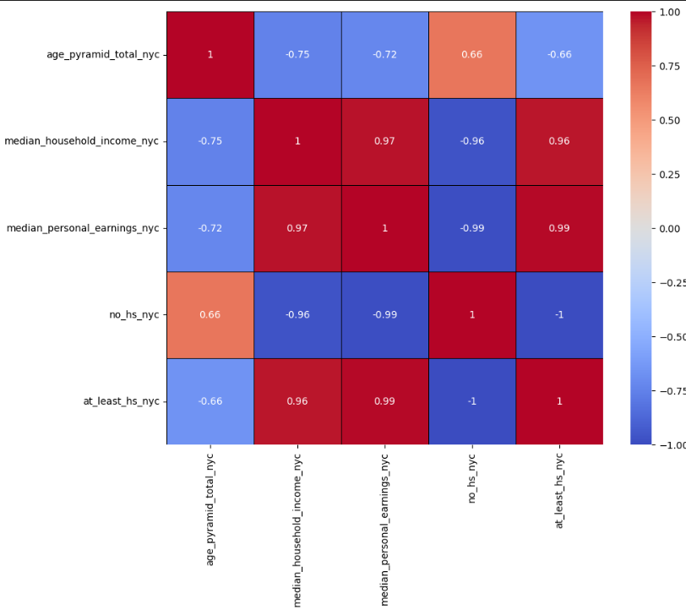
Correlation Matrix (Top 5 variables)
Zoom in to just 5 variables compared.
1 - Strong Positive Correlation : The closer to 1 or the more red it is the stronger the correlation
-1 - Strong Negative Correlation :
The closer to -1 or the more blue, the stronger the negative effects are.
We ignore values exactly 1 because they are correlated to themselves.

Slide 28
Recommender System - Implementation
Implemented using a function our team developed. The code was written in Python
Goes through all the correlations of the selected variable and returns the ones with the highest correlation depending on how many the user wants

Slide 29
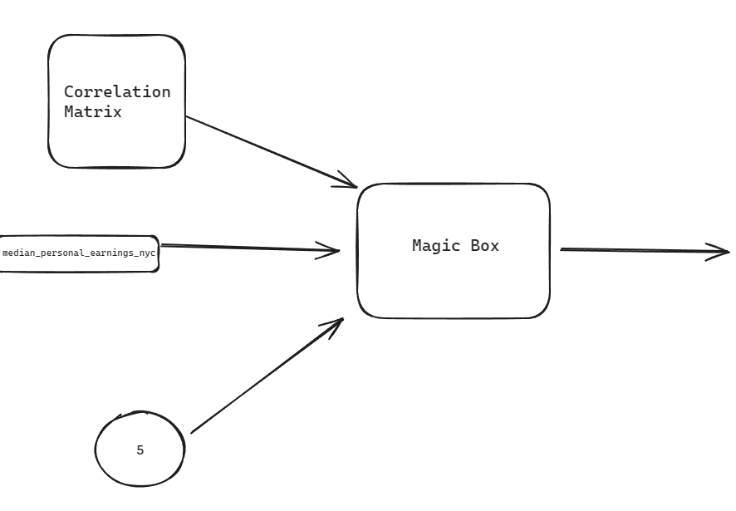
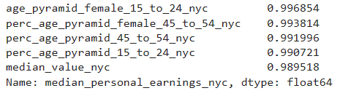
Recommender System - How it works

Slide 30
VI. Chatbot

Slide 31
Chatbot Implementation - Overview
Due to time constraint our team opted to utilize OPEN AI’s GPT-3.5-Turbo to implement a correlational analyst. Another option was to implement our own RAG model (LLM like Chat GPT), but we were short on time.
Open AI’s models requires a few things. It needs our data retrieved to be converted into something it understands.
From Correlation_Matrix.csv -> knowledge.txt, using a python function implemented by the team.

Slide 32
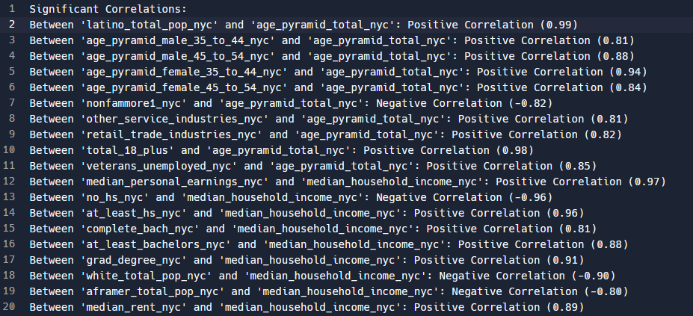
Chatbot Implementation - Data Conversion
Correlation_matrix.csv knowledge.txt

Slide 33
Chatbot Implementation - Creation of our Model
Written in python, code was written to host our model that was connected to Chat-GPT’s api on the back end.
We trained our model using the `knowledge.txt` file that was generated previously
In Open AI’s API it indicates that we have to give it specific instructions on how it will analyze our data. After tinkering we finally ended up with a working model that fits specifically for our use case.

Slide 34
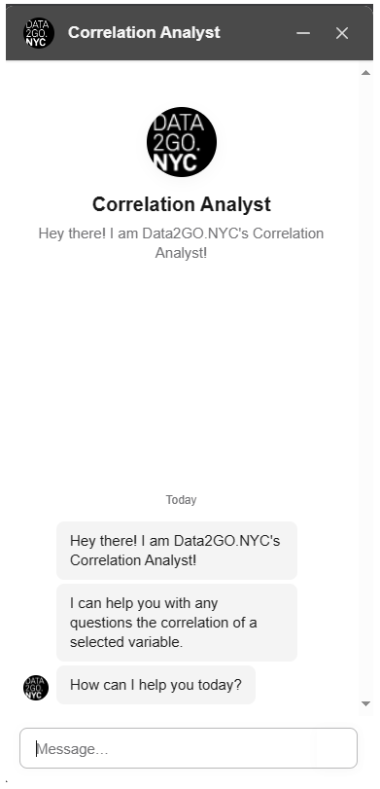
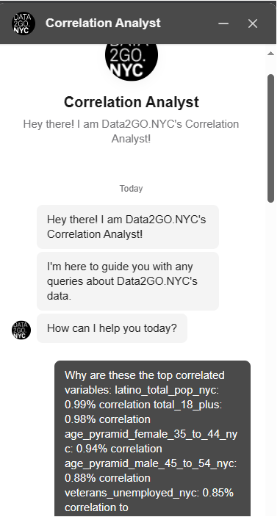
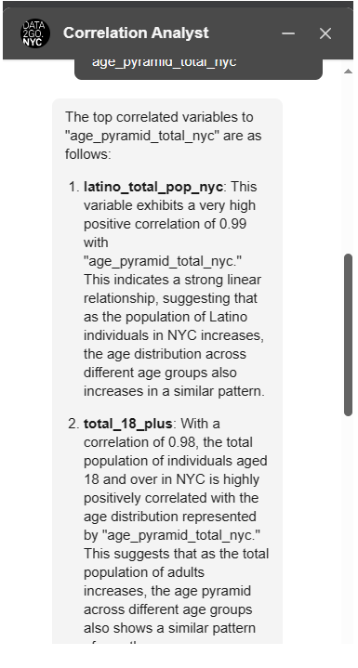
Chatbot Implementation - How it looks

Slide 35
VII. Implementation - Putting it all together

Slide 36
How do we implement and tie everything together?
We wanted to tie everything together and for it to work as a unit.
Webpage was written in REACT/Js
Backend of the Chatbot was written in Python
Recommender System was originally written in python but was converted to javascript
Note, Backend of the webpage is completely separate from the backend of the chatbot
This webpage could be implemented on DATA2GO.NYC when people are looking for variables, the input could be the user’s click.

Slide 37

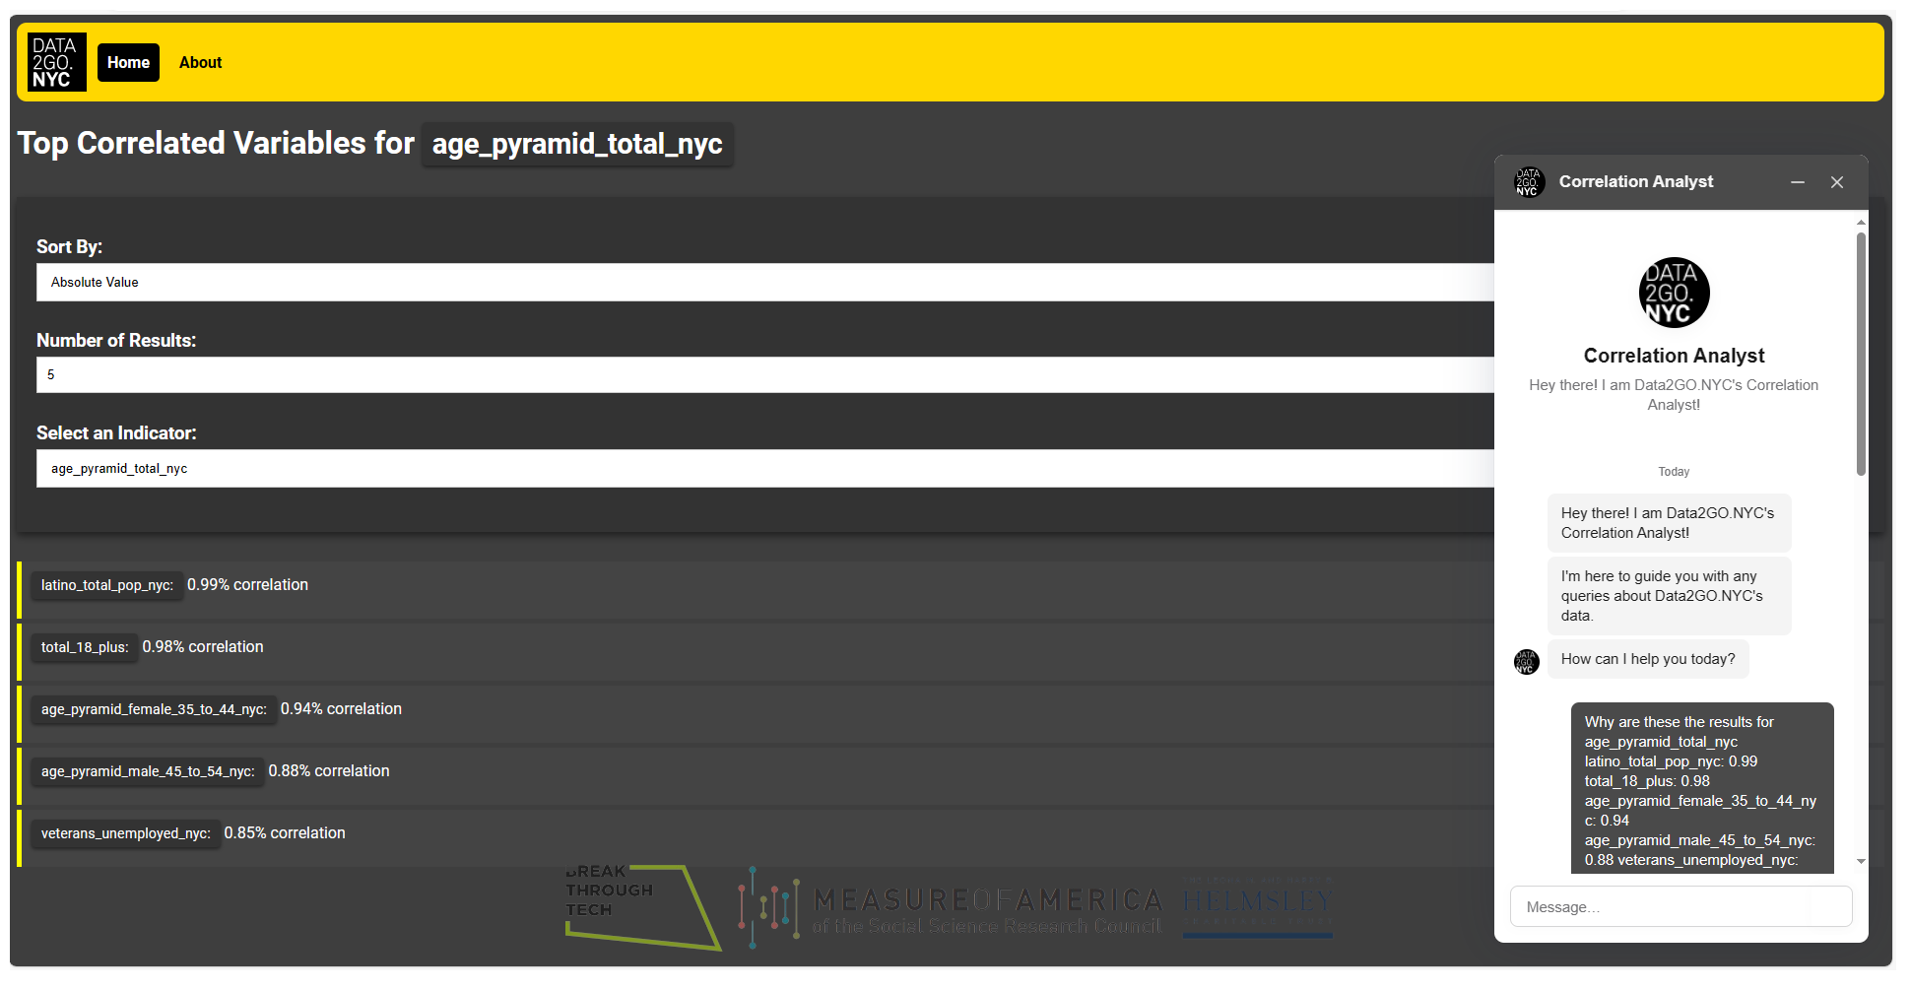

Slide 38
VIII. Demo

Slide 39
Final Thoughts

Slide 40
What We Learned
How to work with RStudio
How stressful it is to look for data and to clean up outdated datasets
Machine learning cycle from data exploration to implementation
It is not linear. Most of the time you think you have something figured out but you don’t
The importance of being able to learn on the fly

Slide 41
Potential Next Steps
Implementation on DATA2GO.NYC
Changing the recommender system to dynamically recommend when a user clicks on a variable
Chatbot will be available on the website

Slide 42

Questions?

